Slide 1
CoTwin
Saghar Alvandi, Sadhana Anandan & Robert Kupferschmied
Summer 2025

Slide 2
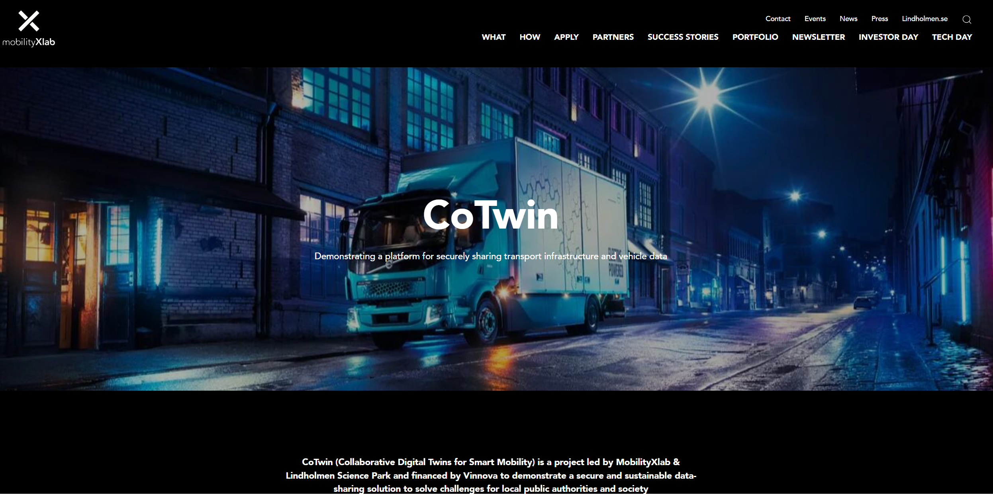
Introduction
CoTwin – Collaborative Digital Twins for Smart Mobility
Goal
CoTwin | MobilityXlab

Slide 3
Agenda
Background
Use case
Solution
System overview
Technical details
Demo
Conclusion
Future work

Slide 4
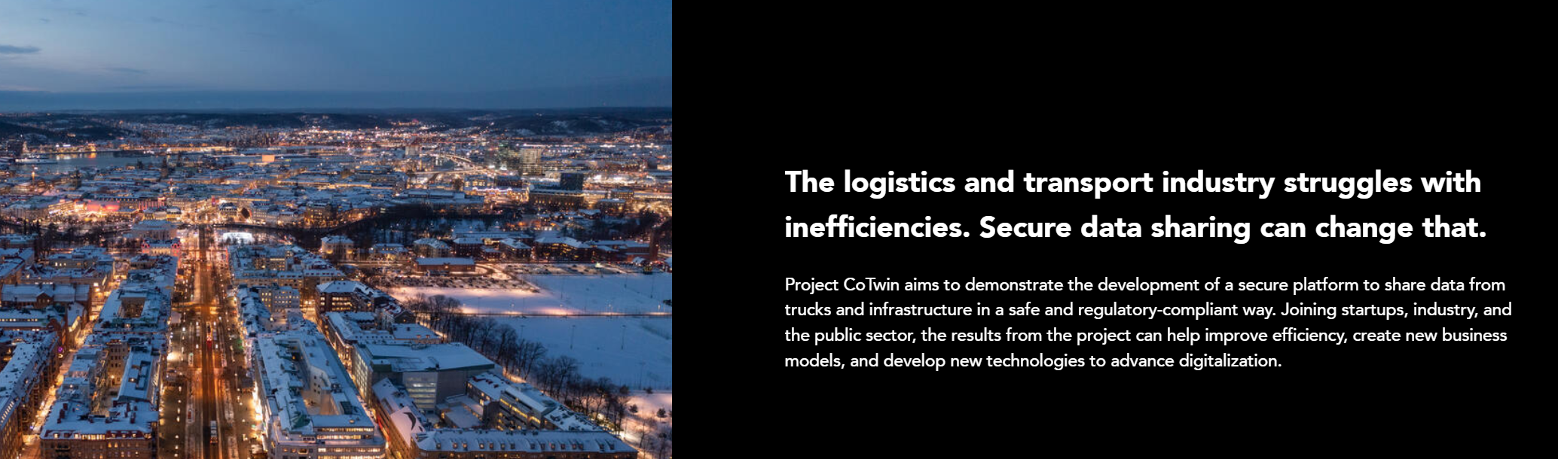


Slide 5
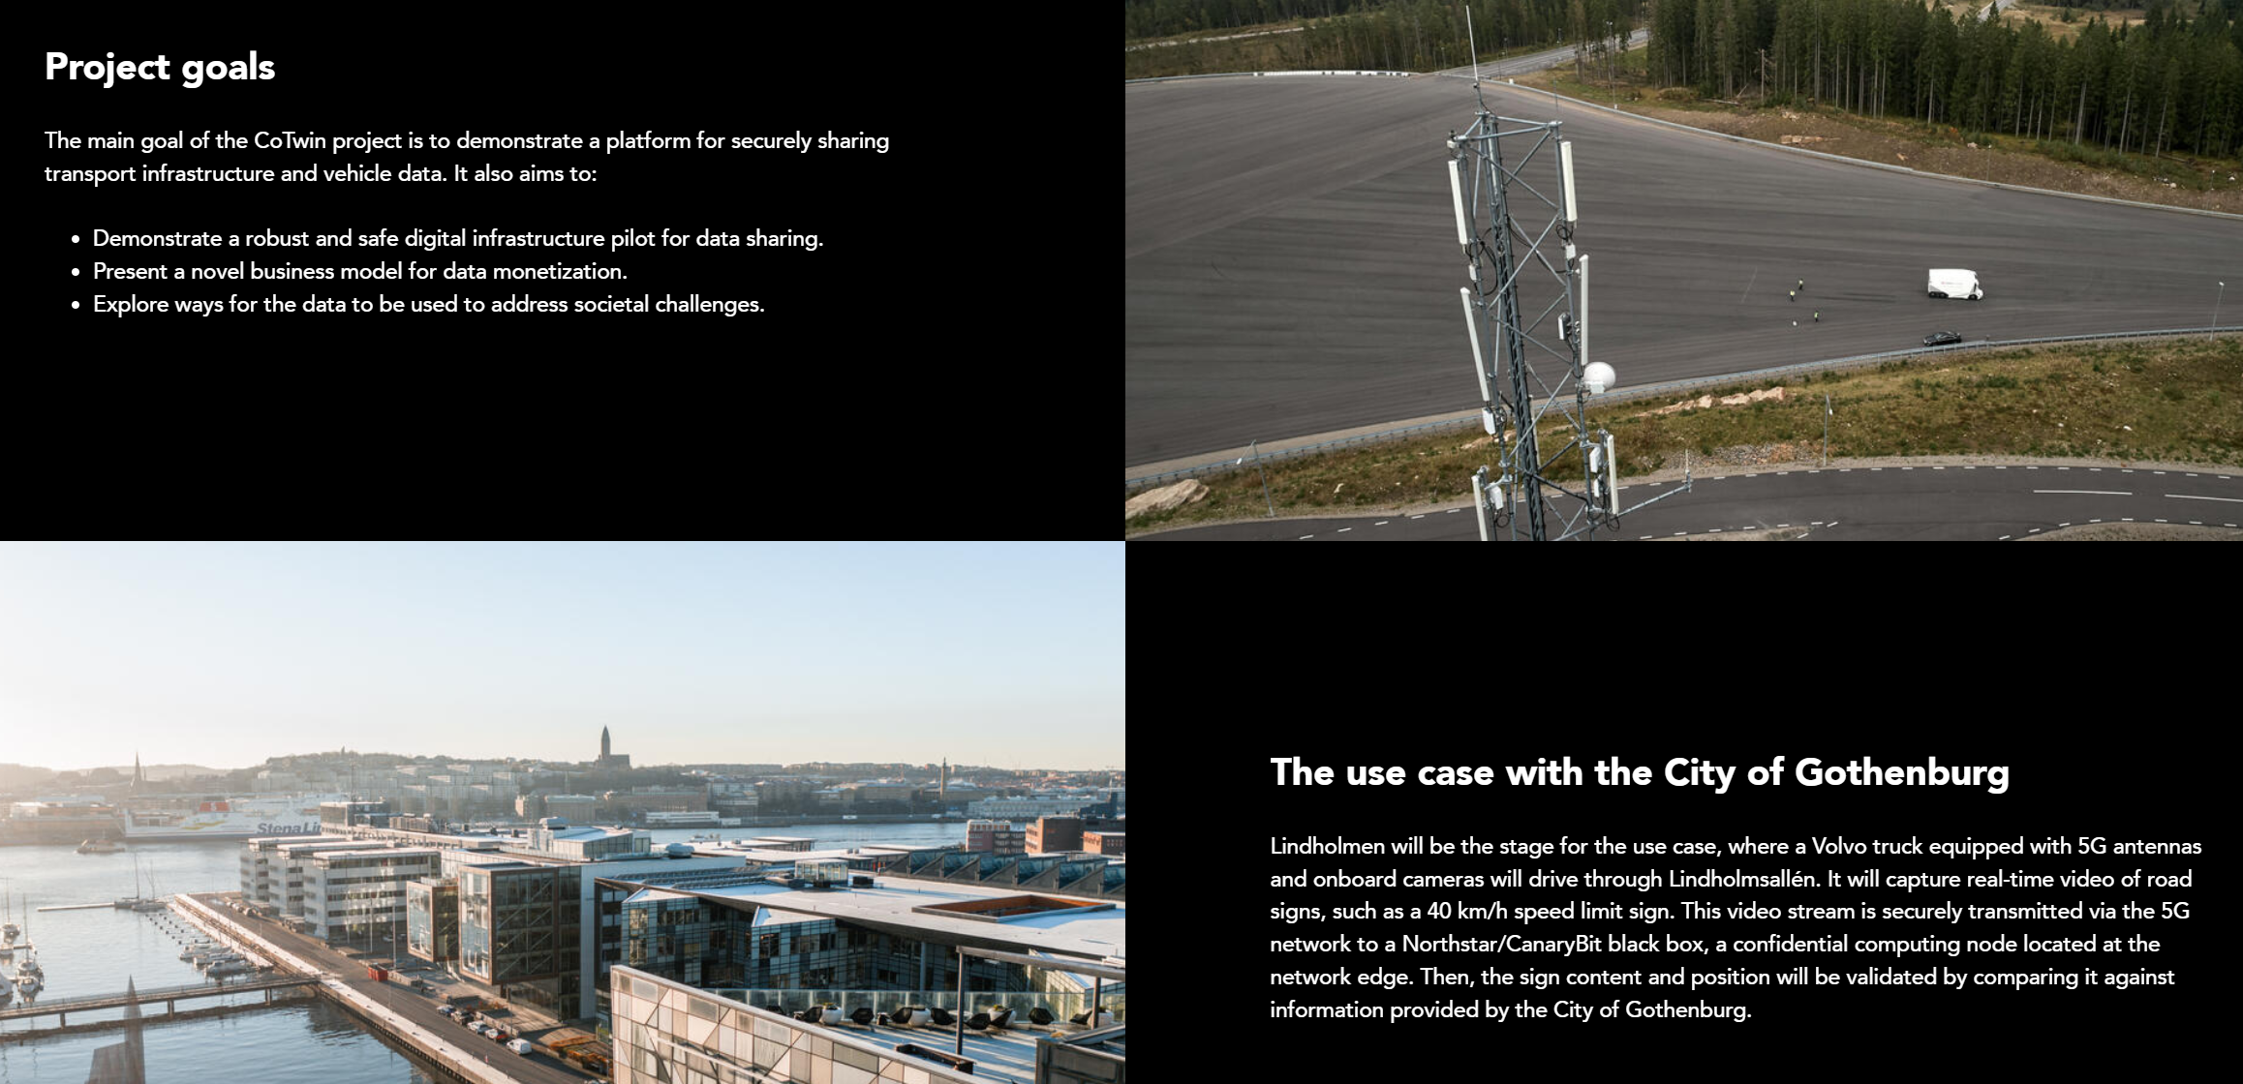
The Problem?
Data sharing is complex, and generating real value often entails significant infrastructure costs. Additionally, legal regulations such as GDPR and security concerns pose obstacles or cause lengthy delays in developing solutions.
Running AI demands substantial data and computing power. Vehicle-based computing, particularly AI processing, is a limited resource. Relying on cloud computing introduces high data transfer costs, latency issues, and further complications related to legal frameworks like GDPR.
Cotwin aims to address these challenges comprehensively.
Notes:
The Challenge
Data sharing is complex, and generating real value often entails significant infrastructure costs. Additionally, legal regulations such as GDPR and security concerns pose obstacles or cause lengthy delays in data sharing and processing.
A clear opportunity to unlock value from data lies in AI, yet running AI demands substantial data and computing power. Vehicle-based computing, particularly AI processing, is a limited resource. Relying on cloud computing introduces high data transfer costs, latency issues, and further complications related to legal frameworks like GDPR.
Cotwin aims to address these challenges comprehensively.

Slide 6
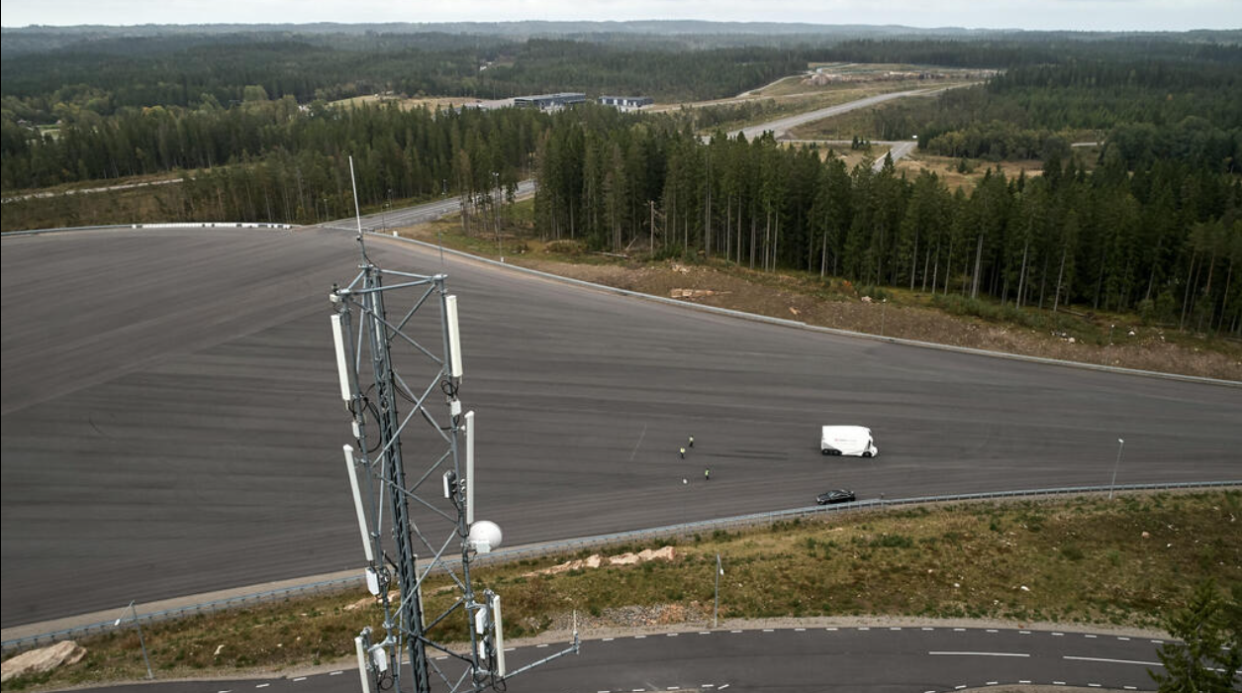
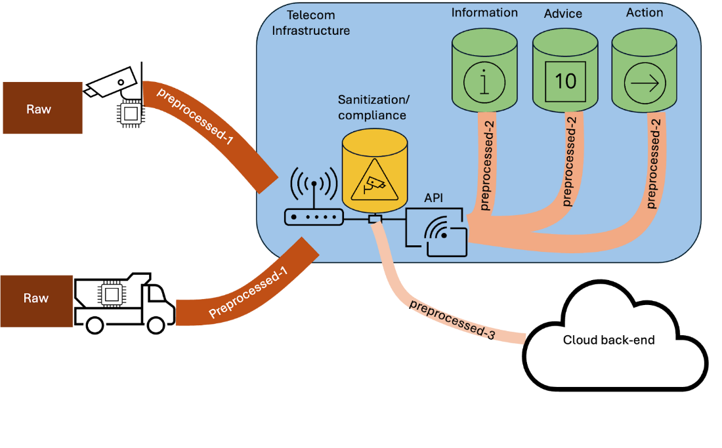
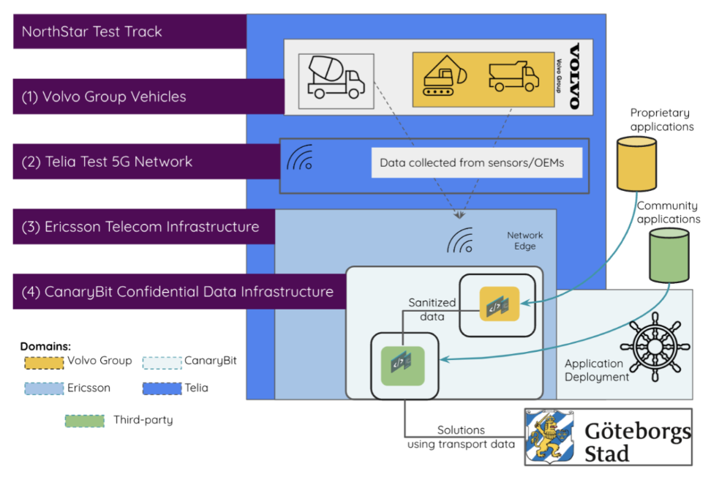
The Solution
To address data transfer costs, legal challenges, and the lack of onboard computing power, we propose implementing edge computing.
Edge computing can take various forms; for Volvo, it involves onboard computing in trucks, while for others, it might be roadside camera units with additional computational capabilities.
In the CoTwin project, the "Edge" refers to computing just behind the base stations, potentially becoming part of future telecom infrastructure provided by Ericsson and operators here represented by Asta Zero (Telia).
This Edge is equipped with state-of-the-art secure computing and data-sharing technology provided by CanaryBit.
Sensor data collected from Volvo Group vehicles and other infrastructure sensors can be processed at this Edge and shared both within the Edge and with traditional cloud computing systems.
A key innovation in this project is a legal investigation conducted with IMY (Integritetsskyddsmyndigheten) to determine if this computing can be considered GDPR-compliant/free. In practice, this would mean that Volvo-specific data processing in CoTwin would be treated as if it were processed within the truck.
Notes:
To address both data transfer cost, legal challanges and lack of compute onboard an obvious approach would be to create some kind of Edge compute.
Edge compute is used in a variety of cases and the actual edge can be many things, for Volvo it is the onboard compute in the truck and for other players it can be in a roadside camera unit with some additional computational capability, etc.
In the CoTwin case the ”Edge” is a compute just behind the base stations which then can be a future telecom infrastructure capabilities from Ericsson to supply to Operators, in our case represented by Asta Zero (Telia).
This Edge is then equipped with a state-of-the art secure compute and data sharing technology, in this project provided by CanaryBit.
In this edge sensor data collected from Volvo Group vehicles and other infrastructure sensor systems can processed and after that shared to others both in this Edge but off course also to our traditional cloud compute.
Another key innovation in the project is a Legal investigation together with IMY (Integritetsskyddsmyndigheten) that will analyze if we could see this compute as GDPR free compute, in practice that would mean that a Volvo specific data processing in CoTwin would be as if it was processed in the Truck.

Slide 7
Use Case
Summer worker | Internal
2025
Notes:
So we will begin by discussing the use case that was presented to us.

Slide 8

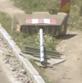

Use Case
From: Gothenburg Municipality
Problem:
Very difficult to maintain and track road signs
Very expensive and time consuming to send people out for checking every location and condition of each road sign
Huge safety gap
Solution?
Summer worker | Internal
2025
Notes:
Road signs are crucial for road safety and traffic management, they keep us safe on the road and prevent accidents, but they are also very dificult to maintain and track.
Generally, people are sent out to manually check every sign on every road, which is not only boring but also very expensive and time consuming.
What if a sign gets knocked down just a day after it's been inspected? The municipality would not know for weeks or months, which creates a huge safety gap.
For example, let us take a look at this fallen road sign. This is from Lindholmsallen and from what we can see, it has been in this state for the entire summer.
This is a clear problem, especially now with the large-scale construction on that road, where road signs are more important than ever.
And this is the use case that was presented to us by the Gothenburg municipality it became the core problem our project was designed to solve.
So what is a good solution for this?

Slide 9
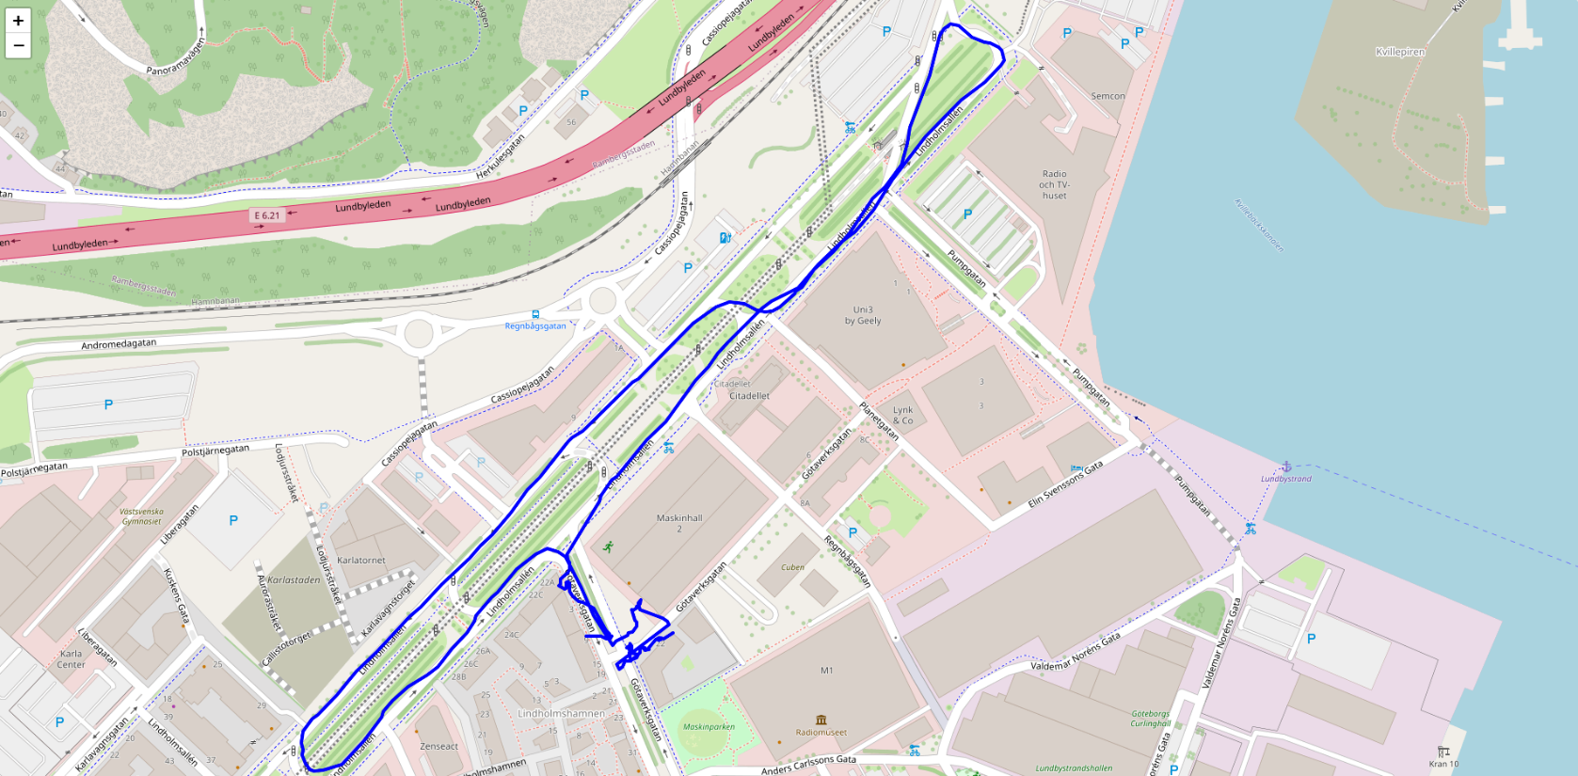
Use Case
Solution: To detect signs on the road using truck camera and verify with the gothenburg municipality data
Many approaches
Summer worker | Internal
2025
Notes:
Well the solution is to use the truck cameras while it is driving around to detect roads signs and collecting that information.
Then we will verify the collected data with the municipality’s database, to see if all the sign locations and conditions are up to date.
To implement this solution, many approaches can be taken:

Slide 10


Use Case
Solution 1: All the computational power and data processing directly on the truck.
Reliability – no internet connection
Reduced bandwidth cost – low latency
High hardware costs
Limited scalability
High maintenance
Summer worker | Internal
2025
Notes:
The first solution is to have all the computational power and data processing directly on the truck.
This has two key benefits: it allows for real-time analysis of road signs without any reliance on an internet connection, and it results in reduced bandwidth costs since very little data needs to be transmitted.
However, this method comes with significant drawbacks.
It requires expensive and powerful on-board hardware, which can be a major constraint.
Furthermore, this approach has limited scalability and high maintenance costs, as each truck would need to be physically updated and serviced individually.

Slide 11
Use Case
Solution 2: A centralized cloud-based system, where the truck's camera would stream all of its raw data to a remote server. The server would then process the information and send the results back to the truck.
Scalability
Simplified maintenance
Low initial costs
High latency
High bandwidth costs
Reliant on connectivity
Summer worker | Internal
2025
Notes:
On the other hand, we could use a centralized cloud-based system, where the truck's camera, streams all of its raw data to a remote server for processing.
This approach has many benefits: it's highly scalable, as we can add more data and user capacity in the cloud.
It has lower initial costs since the hardware on the truck can be minimal, and lastly the maintenance is also simplified as all updates are done in one central location.
However, this method has significant drawbacks as well. The major issue is latency.
The time required to transmit each video frame to the cloud and wait for a response would take too long for real-time applications.
Furthermore, it is entirely reliant on a stable internet connection, and streaming large amounts of raw video data can result in high bandwidth costs.

Slide 12
Use Case
What if we can get the best of both?
Low latency, real time processing with minimal computation power on truck.
CoTwin!
Summer worker | Internal
2025
Notes:
But what if we can get the best of both approaches?
A solution that provides low latency, real time processing with minimal computation power on the truck?
This can be achieved through CoTwin and it’s use of edge computing.

Slide 13



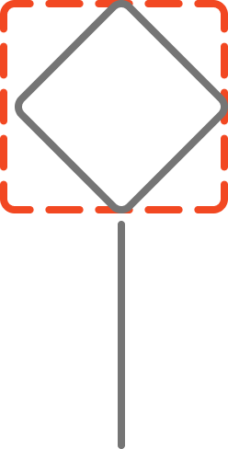

Use Case
Summer worker | Internal
2025
Notes:
Edge computing is a decentralized computing model that brings data processing and storage closer to where the data is created, at the "edge" of the network.
Instead of sending all data to a centralized cloud or data center to be processed, edge devices or local servers analyze and act on the information right away.
In our case, we would have many edge compute towers stationed around the town.
So what would happen is that when the truck drives around and detects a road sign, it will send this information to the closest tower, where it will process all the information in real time and send respond back to the truck with low latency.
Moreover, these compute towers can be connected to one large centralized cloud, thereby sharing the information across all towers as well.

Slide 14
Overview
Summer worker | Internal
2025
Notes:
Let us take a quick look at the overview.

Slide 15


System Overview
Video Stream
Truck App
Tower App
Summer worker | Internal
2025
Notes:
This is a highlevel overview of the system we developed this summer.
We have 3 main components, we refer to them as a video stream, truck app and tower app.
The video stream will stream the video from the truck camera to the app on the truck, which will then send individual frames to the nearest tower app, where we will get a confirmation whether there was a road sign on the frame or not, and then the tower app will send a response back to the truck app. This will be discussed in detail a bit later.

Slide 16
Data
Summer worker | Internal
2025
Notes:
We will first talk about the data we used to develop this system and how we collected it.

Slide 17
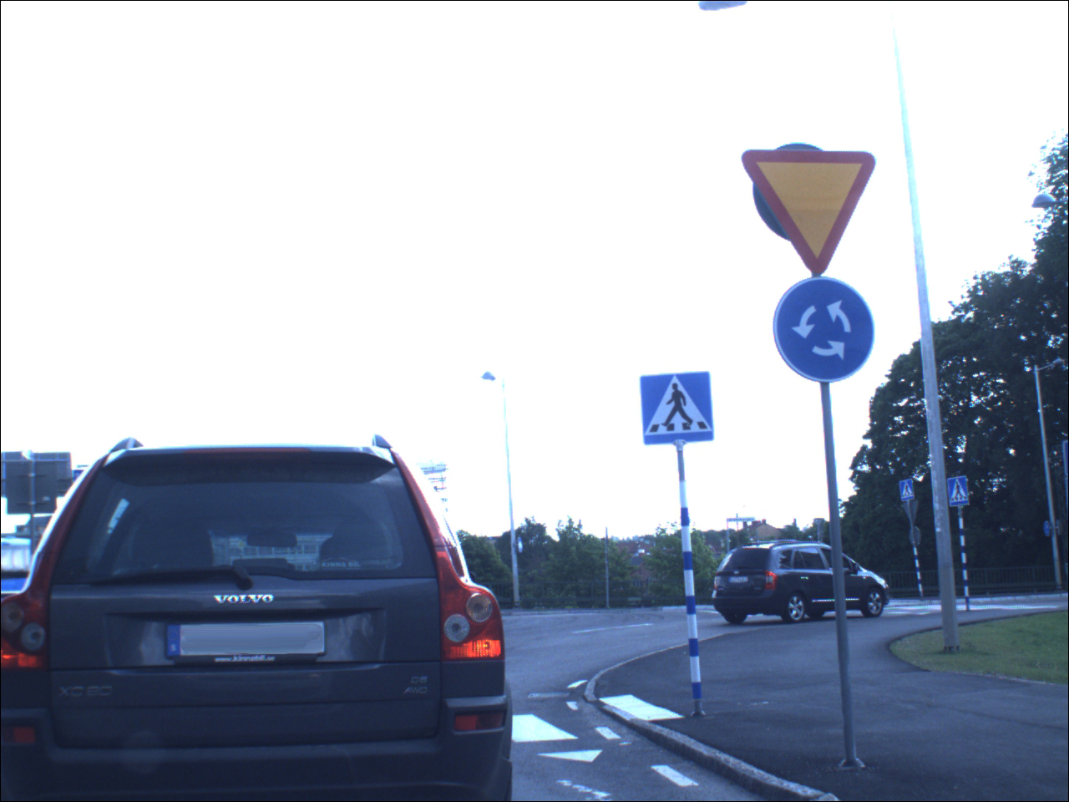
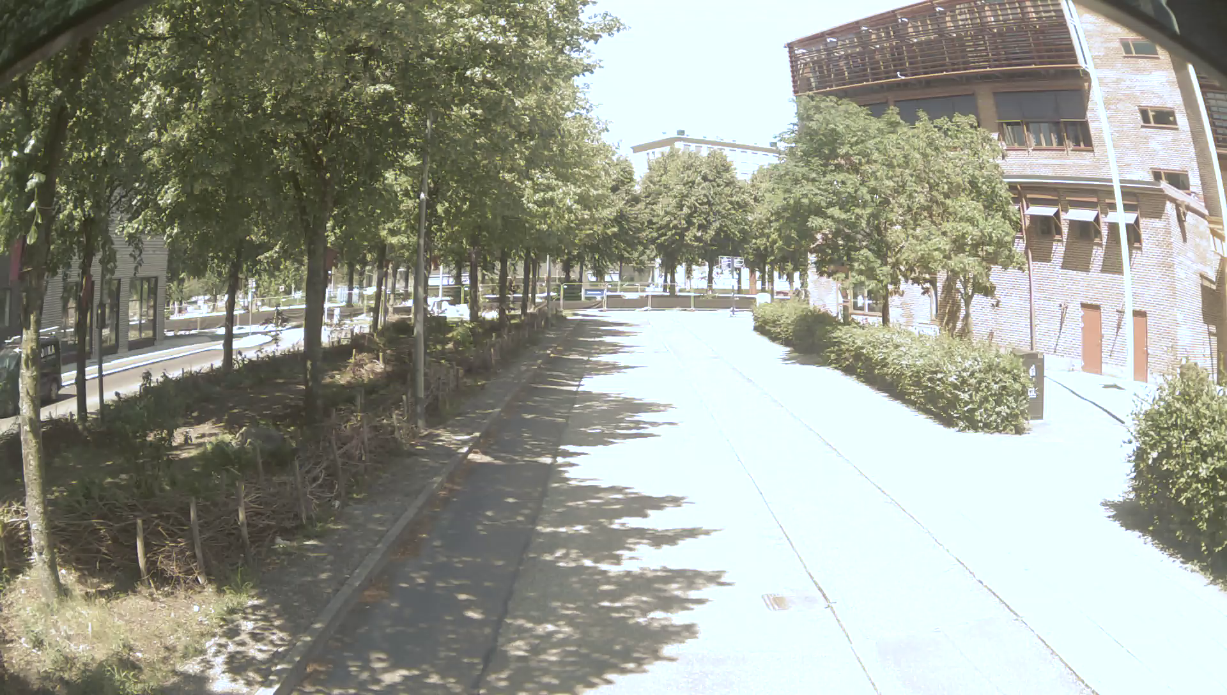
Linköping University Dataset
4000 labelled images
3488 swedish road signs
Cons:
Data is NOT from lindholmen
Low height of the camera
Standard lens and NOT fisheye lens
Summer worker | Internal
2025
Notes:
We first found a dataset published by the university of Linköping, which consisted of 4000 labelled images consisting of 3488 swedish road signs.
While this dataset was good with a large quantity of annotated data, consisting of many road signs, it did not fullfill all of our requirements.
Mainly, we dont have any local data to verify with the municipality’s database.
Secondly, the camera with which these images were captured was placed quite low, especially in comparison to a truck camera.
This is important since we want to train our model with road signs as a truck would view them.
And lastly, the camera also used a standard lens and not fisheye like the truck cameras have.
A fisheeye lens is when the camera captures an extremely wide-angle image, distorting the image and making straight lines appear curved. We needed to account for this distortion to ensure our model could accurately detect signs from a truck's perspective.

Slide 18
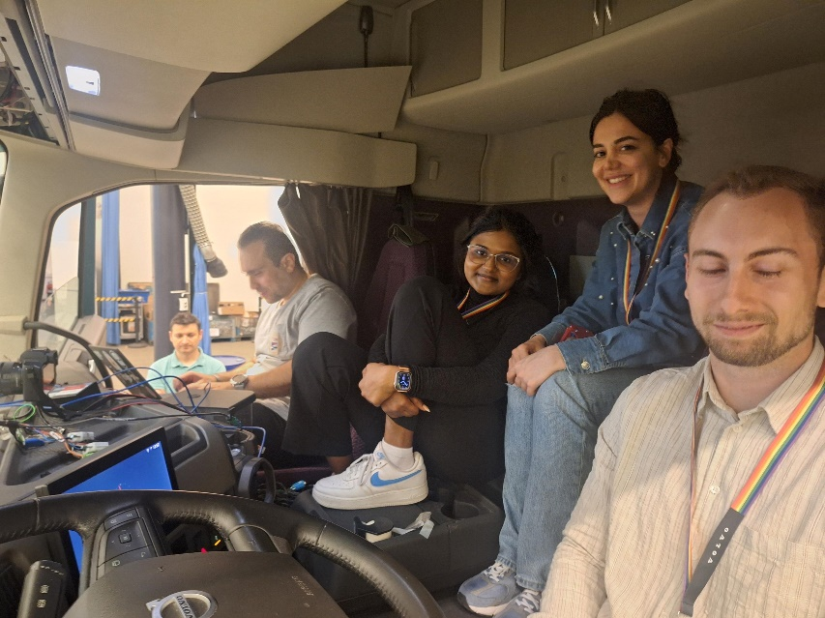
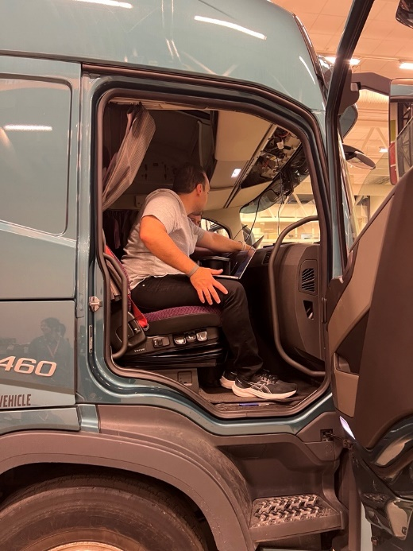
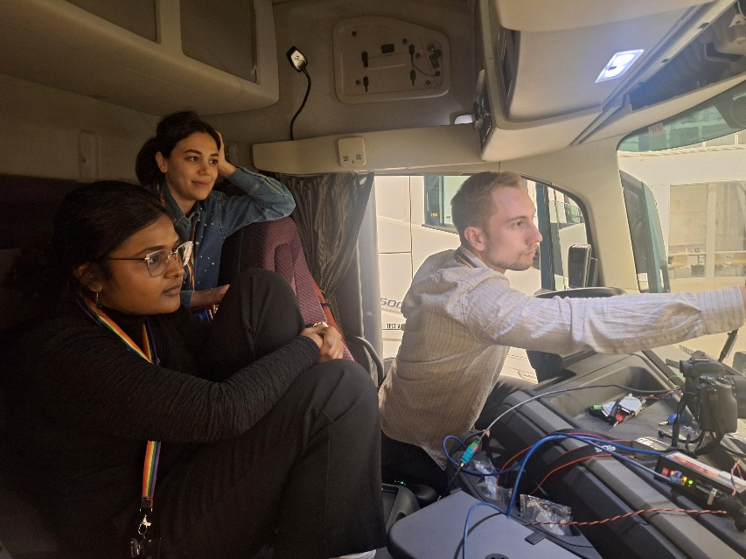
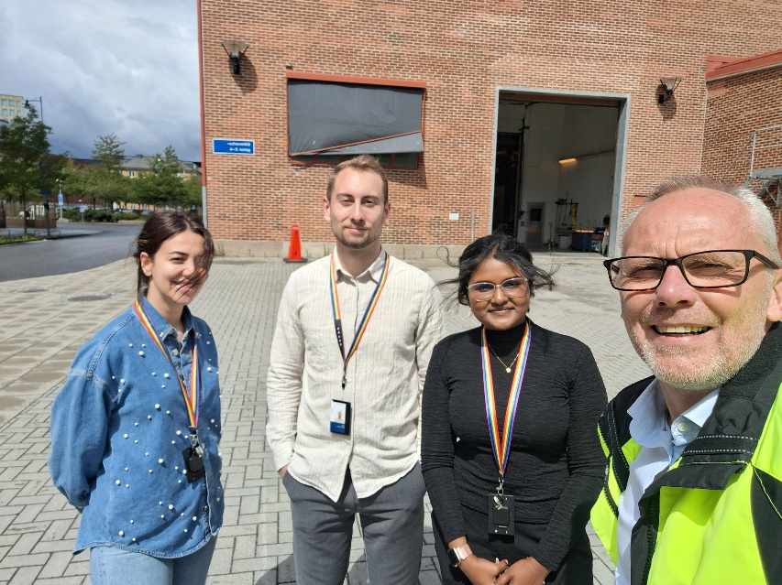
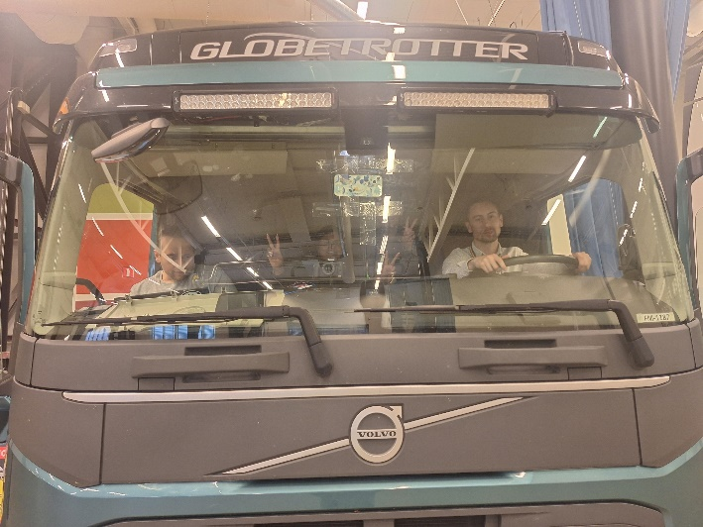
Lindholmsallén Dataset
Drove around in the truck
Collected data using fisheeye camera from truck
Fulfill the gothenburg municipality requirements
Summer worker | Internal
2025
Notes:
Therefore, in addition to the Linköping dataset, we also drove around lindholmsallen in a truck and collected our own data.
By doing so we were able to collect images with a fisheye lens and collect road sign data specific to linholmen.

Slide 19
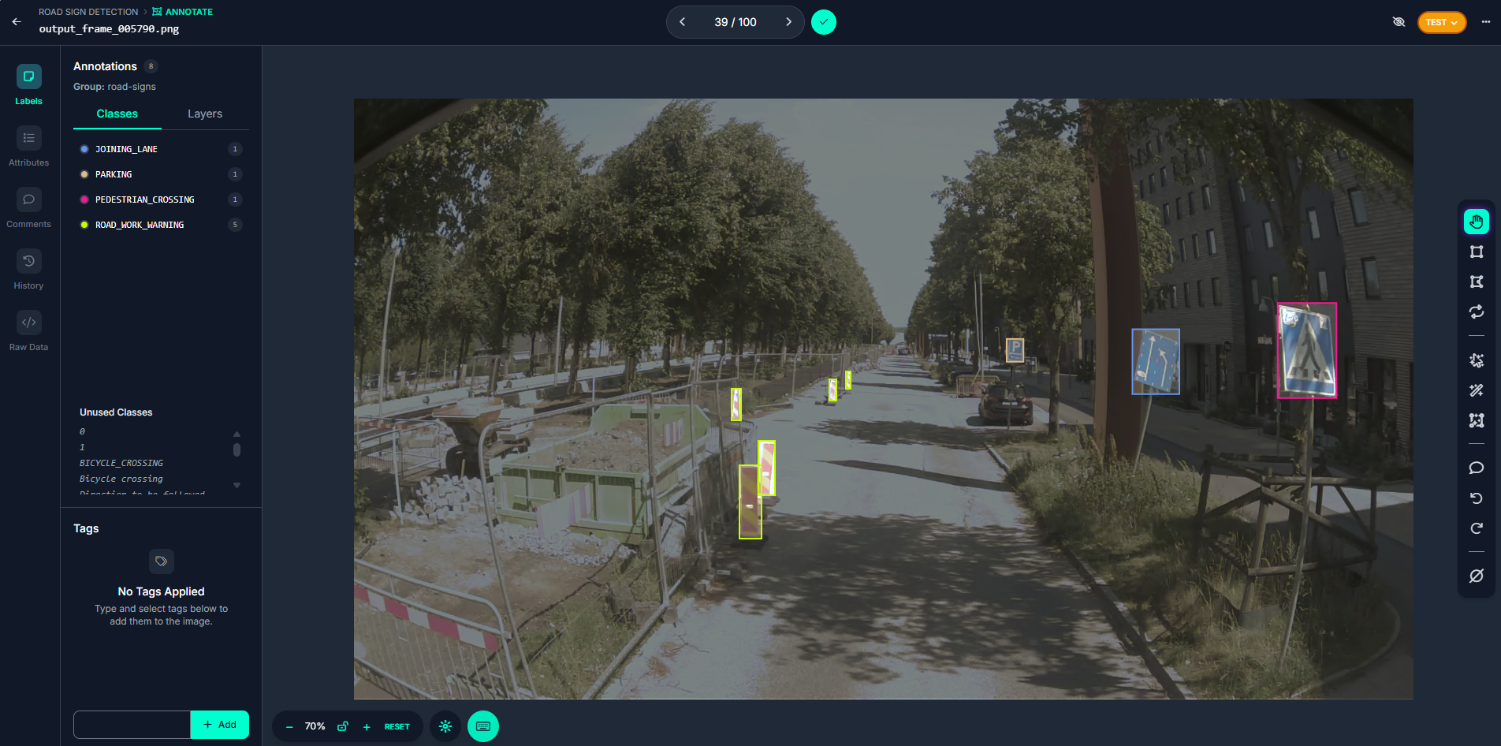
Lindholmsallén Dataset
We labelled the data using roboflow
Summer worker | Internal
2025
Notes:
After collecting our video data, we used a computer vision platform called roboflow to label and annotate the dataset.
First, we extracted individual frames from the video footage and uploaded them to the platform.
Then we manually drew a bounding boxes around each road sign.
A bounding box is just a rectangle around an object, and by doing so we can extract the coordinates surrounding the object.
These coordinates are then fed to the model along with the images, so it knows exactly where in the image the road signs are.

Slide 20
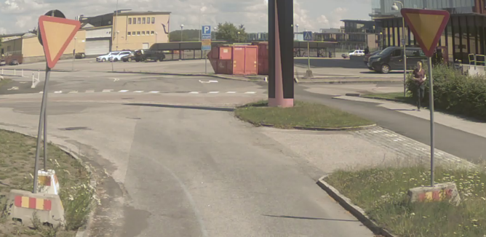
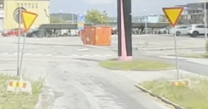
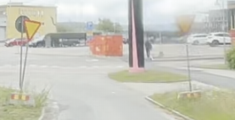
Lindholmsallén Dataset
Data augmentation – techniques used to artificially increase the size and diversity of a dataset
Rotation
Blur
Brightness & Exposure
Summer worker | Internal
2025
Notes:
Lastly, to make our model as robust as possible, we applied some data augmentation techniques to the data we collected.
Data augmentation is a set of techniques used in machine learning to artíficially increase the size and diversity of a dataset.
Let's look at these three pictures of the exact same road signs in the same location.
Even though they show the same signs, each one looks a bit different.
The image on the left was taken on a sunny day. The sun was on the right side, which created a strong shadow, making the sign on the left look bright while the one on the right looks dull.
In the middle picture, you can see both signs look the same. This was because the photo was taken on a cloudy day.
In the image on the right, the camera lens is foggy from the rain, making one sign look clear and the other barely visible.
As humans, we can easily recognize a road sign in any of these scenarios, but an AI model can’t.
It only knows what a sign is based on the data we feed it.
Therefore, to ensure our model could handle all these real-world conditions, we applied various techniques to our data, so it can recognize signs even if they are affected by weather or other factors.
Some of the key techniques we used include:
Rotation: To account for signs that may be tilted.
Blur: To simulate fog, rain, or a dirty camera lens.
Brightness/Exposure: To train the model on signs in different lighting conditions.

Slide 21
Video Stream
Summer worker | Internal
2025
Notes:
Now i will talk about the video stream from the camera to the truck app

Slide 22










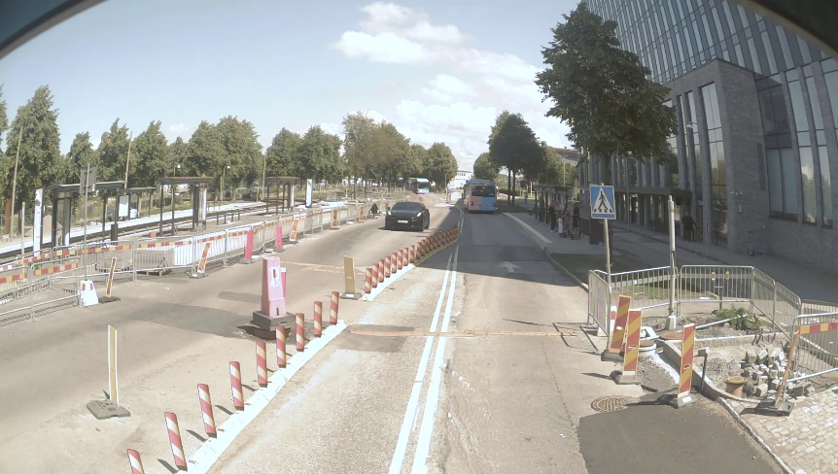

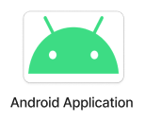
Video Stream
Streams through AVTP over Ethernet
Tried to mimic the real camera
UDP with ffmpeg
7.5 FPS from truck recording
30 FPS from phone recording
Notes:
Camera streams through AVTP (Audio Video Transport Protocol)
Over Ethernet
Don’t have access to a truck all the time had to come up with something else to test the app.
To mimic the camera we use recorded video and stream it to the app.
Ffmpeg to stream it via UDP (User Datagram Protocol)
UDP does not need a confirmation from the receiving side
App listens for everything and UDP packets gets sent to the app.
Then on the app these packets gets decoded to a frame.
7.5 frames per second with some corrupted frames. Up to 15 FPS
Recorded with phone (30 fps). In app took every 4th frame to mimic 7.5 fps.

Slide 23
Truck App
Summer worker | Internal
2025
Notes:
I will talk about the app located on the truck

Slide 24
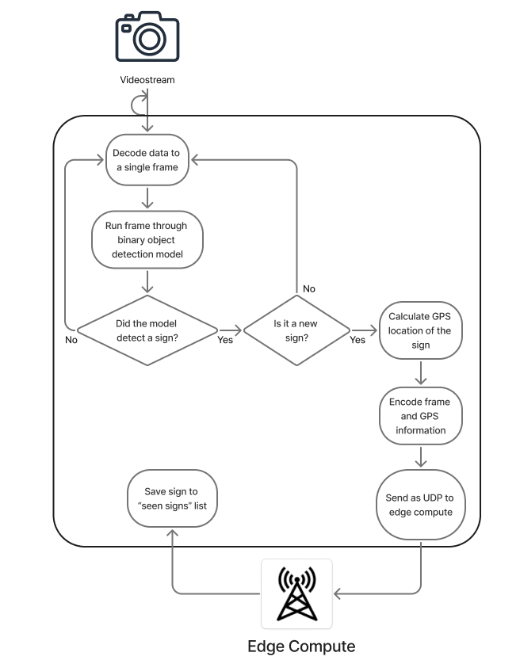
Truck App
UDP packets as input
Flowchart of the app
Logic to reduce bandwidth
Model used as filter
Images resized
Only send new signs
Dealing with multiple signs
Summer worker | Internal
2025
Notes:
UDP packets as inputs
Go through flowchart
Could send all frames to tower. OD model acts as a filter to reduce bandwidth.
Resized images when ran through model
Don’t send frame if it contains an already seen sign.

Slide 25
Truck App Model
Summer worker | Internal
2025
Notes:
Now I will be talking a little about the object detection model we have on the Truck App.

Slide 26
Truck App Model
Binary classification model
YOLOv11 Nano (”You Only Look Once”)
Transfer learning
Model quantisation
Accuracy: 82%
Output - bounding boxes coordinates
Above 50% confidence
Notes:
As mentioned previosuly, The purpose of having a model on the app is to reduce bandwidth and latency. Instead of sending every image to the tower, the app first checks if there is a road sign in the frame or not. This is done with a binary classification model – it only decides if a sign is present or not, without classifying what sign it is. (Saghar)
For this, we used YOLOv11, the latest version of the YOLO models (“You Only Look Once”). YOLO models come in different sizes. we chose the nano version, which is the smallest and fastest one. While it is less accurate than larger models, but speed is the main priority for the app. (Saghar)
We used transfer learning to train the model, which means It first learned from a large dataset and was then adapted for our task. We started with the Linköping dataset of Swedish road signs, relabeling it for binary detection. After that, we retrained the model on the Lindholmen dataset so it could also detect local signs captured with a fisheye camera. (Saghar)
We wanted the truck app model to be as small as possible, in order to avoid taking up space and computational resources on SEM, therefore we performed model quantisation, which is an optimization technique that reduces the size and computational requirements of a model without significantly sacrificing its performance. So therefore we managed to make an already small model even smaller.
We also managed to achieve an accuracy of 82% accuracy, creating a fast and pretty accurate model. Lastly, the model only outputs all the bounding box coordinates for each road sign it detects that has more than 50% confidence, that is if the probability of it being a sign is more than 50%.

Slide 27
Tower App
Summer worker | Internal
2025

Slide 28
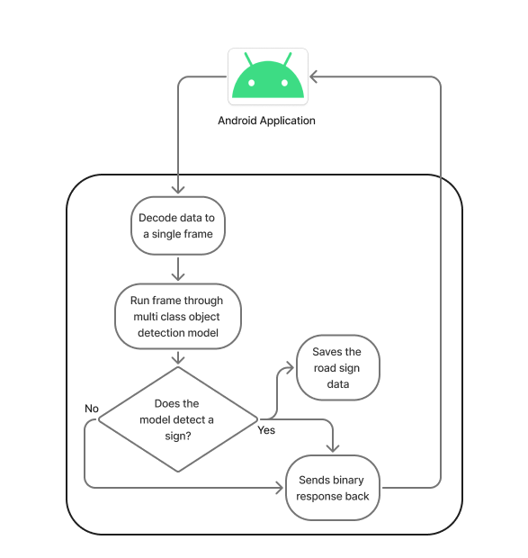
Tower App
Flowchart of the tower
Larger and more advance model
Saving the data on the tower
Image frame
GPS coordinates
Distance to sign
Unique ID
Notes:
Tower app,, which is basically, a program that’s always listening for incoming data from the app that runs on the truck.
Both the tower and the YOLOv11 model are packaged inside a Docker image. This makes everything easier to run, move, and ensures it works the same, on any computer. On the tower, we use a larger YOLOv11 model because of its higher computing power.
Now, what happens is,,, when the tower receives all data packets that belong to the same ID, it tries to put them back together and rebuild the full image. If some packets never arrive, the server will clean up those incomplete assemblies, so they don’t take up space.
Once the image is rebuilt, the tower runs the AI model to look for traffic signs. If a sign is found, the model returns a list of detected signs with confidence scores.
Then, the tower sends a response back to the truck app, saying whether a sign was detected or not. To avoid delays, there’s also a timeout—if the image isn’t processed in time, the server sends a negative response automatically.
Finally, if a sign is actually detected, the tower saves the original image and also generates a text file with the results. That file contains the unique request ID, type of sign that was detected, confidence score, and GPS coordinates of the sign.

Slide 29
Tower App Model
Summer worker | Internal
2025

Slide 30
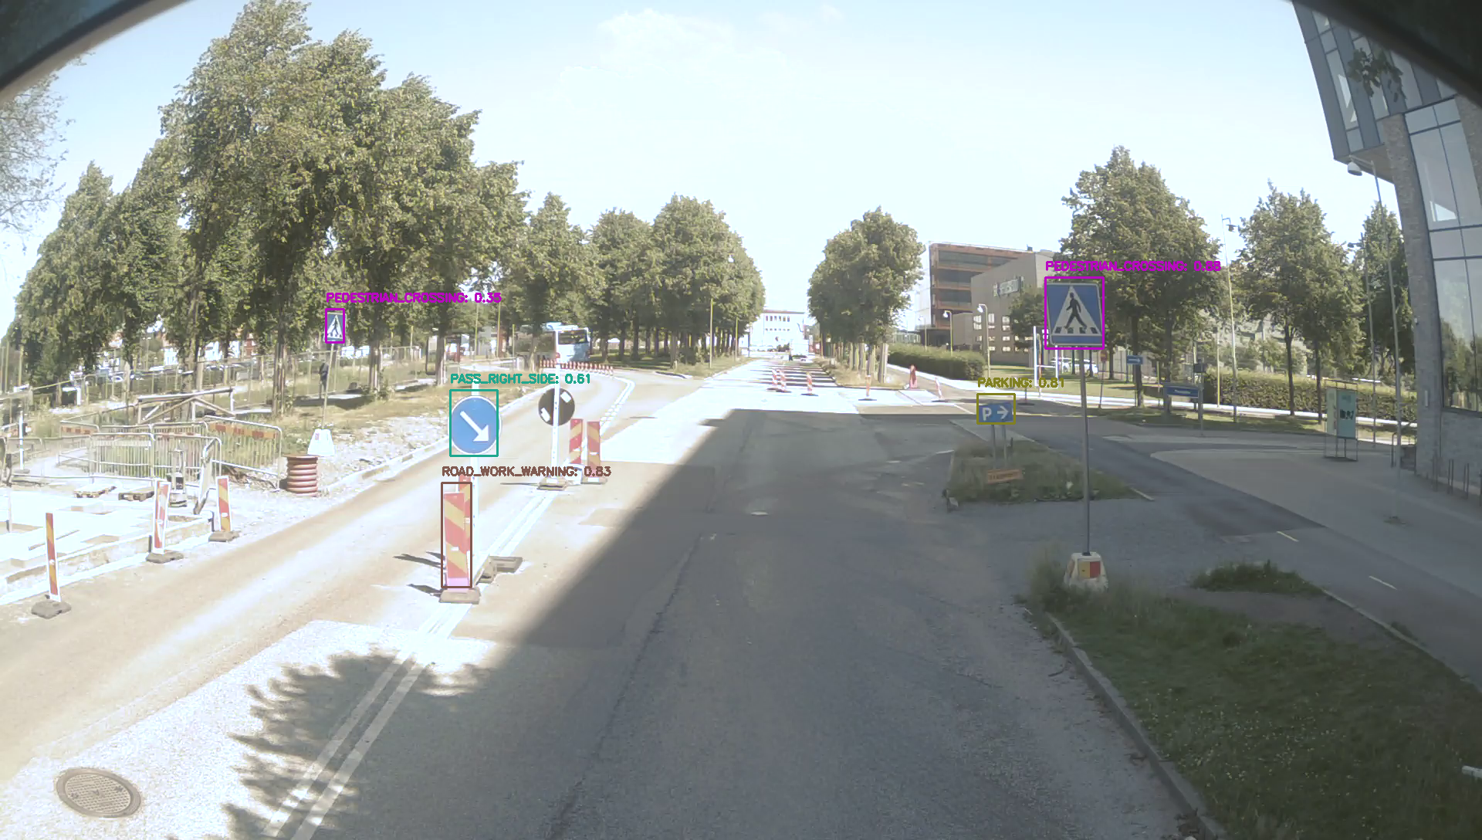
Tower App Model
YOLOv11 Medium
Multi class classification model
Transfer learning
Accuracy: 84%
Notes:
We’ve chosen to use the YOLOv11-medium model for multiclass object detection. Multiclass object detection is that, when the model can recognize different kinds of traffic signs, not just one single type.
The model runs on the tower, and whenever it detects a sign, it also tells us which kind of sign it is. For example, if an image includes multiple signs, the model needs to detect all of them and identify what type of signs they are.
For training, we used transfer learning. Just like the model that we have on the truck app, we first trained it on the Linköping dataset and then continued on the Lindholmen dataset. The final accuracy of the model is about 84%.

Slide 31
Result
Summer worker | Internal
2025

Slide 32
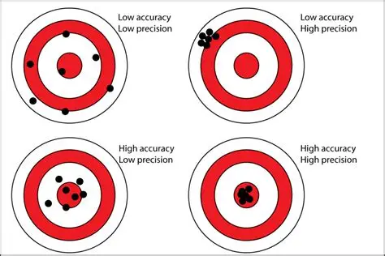
Precision: How many of the detected signs were correct.
Recall: How many of the actual signs the model managed to detect.
mAP@0.5 : Detection with loose match (50% overlap).
mAP@0.5:0.95 : Detection with stricter matches (50–95% overlap).
Accuracy(F1) : Balance between precision and recall (overall accuracy).
Overfitting: Model works well on training data but worse on new data.
Notes:
Before we look at the results, I need to go through some quick keywords — kind of like a mini crash course. Precision is about how many of the detected signs were correct, and recall is how many real signs the model actually found. F1 is just the balance between precision and recall.
Then we have mAP — it’s just a way of testing the model. At 0.5 it’s an easier test, at 0.95 it’s a tougher one.
And last, overfitting is when the model memorizes the training data too well but struggles with new data

Slide 33
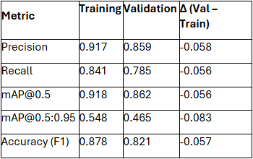
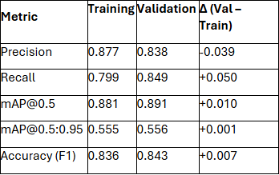
Model evaluations comparison
Yolov11n – Truck app model Yolov11m – Tower app model
Notes:
Result from onboard: The table you see on the left shows the results from the model on the truck application. As we mentioned before ,We used the smallest YOLO version to reduce latency and bandwidth. The model works well, but validation shows lower precision, recall, and F1-score. Stricter evaluation also dropped slightly. This suggests some overfitting, so the model could be improved to generalize better.
Result from offboard:
So, The table on the right shows the results from the model on tower. The model shows no overfitting. Validation performs as well as, or even better than, training. Precision drops slightly but recall increases which means the model detects more objects with a few extra false positives. Since mAP@0.5 and mAP@0.95 stay stable, the model is reliable and generalizes well to new data.

Slide 34
Hardware Integration
Summer worker | Internal
2025
Notes:
Now i will talk about the hardware integration

Slide 35

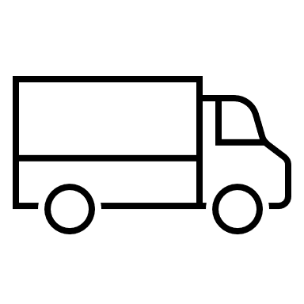


Hardware integration
1 Computer
Truck App on Emulator
Streaming video locally
Running Tower App within docker container locally
Final Goal
Truck App on the SEM on a truck
Receiving data from the truck camera
Running Tower App on a CoTwin tower
3 Computers
Truck App on Emulator
Streaming video
Running Tower App within docker container
SEM rig and 2 computers
Truck App on SEM rig
Streaming video
Running Tower App within docker container
Notes:
The final goal is to have the App on the SEM on a truck, getting the Video from the truck camera and having the Tower app on an actual CoTwin server.
Currently running everything locally, easier while developing. 1 computer, app on emulator, streaming video locally, running docker container locally as server.
To work towards the final goal we tried with three different computers. App on the emulator, streaming video, running app within docker container as server
firewall problems so used Rezas Linux computers.
Problem with rerouting to emulator to receive the stream without performance issue. Because have to do everything with CPU then.
Needed a physical device. Used SEM Rig to run the app.
Problem is that SEM was to fast for the code. The loopback has a small delay.
Tried changing structure on the code entirely, couldn’t manage.

Slide 36
Demo
Summer worker | Internal
2025
Notes:
Show video
Stream video using ffmpeg

Slide 37
Conclusion
Summer worker | Internal
2025

Slide 38


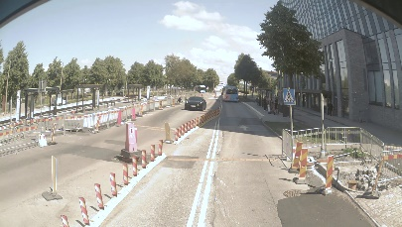

Conclusion
SignIsDetected: True / False
Notes:
To conclude, let us take a look at the diagram we saw in the beginning.
The video stream will send encoded image fragments captured from the truck camera to app on the truck.
On the truck app, the frames will be decoded, and run through a small binary classification model.
The model will then output frames that only have a sign with a confidence of more than 50%.
Then we will apply gps calculation to calculate the gps location of these detected signs.
Then we will encode these frames again and send it over to the nearest tower.
Where it will decode and apply a bigger model to verify if there is a sign and what sign it is.
Then we will store the information regarding the detected sign in a small database on the tower and send a binary response back to the app stating whether the sign detected is true or false for each frame.
Then we could create a centralized volvo cloud and either get the data from the towers or from the app from the truck

Slide 39
Future Work
Summer worker | Internal
2025
Notes:
Then we have future work

Slide 40
Future work
Change structure of the code
Collect more fisheye data
Optimize the models
Handling many signs in one frame
One unique ID per sign
Use pixel location in frame
Notes:
Change structure of code to work on physical device.
Collect more data with the truck camera
With that optimize the model
Handling more signs in one frame, and how that can be done

Slide 41
Thank You!
Any questions?
Summer worker | Internal
2025

